Slide 1
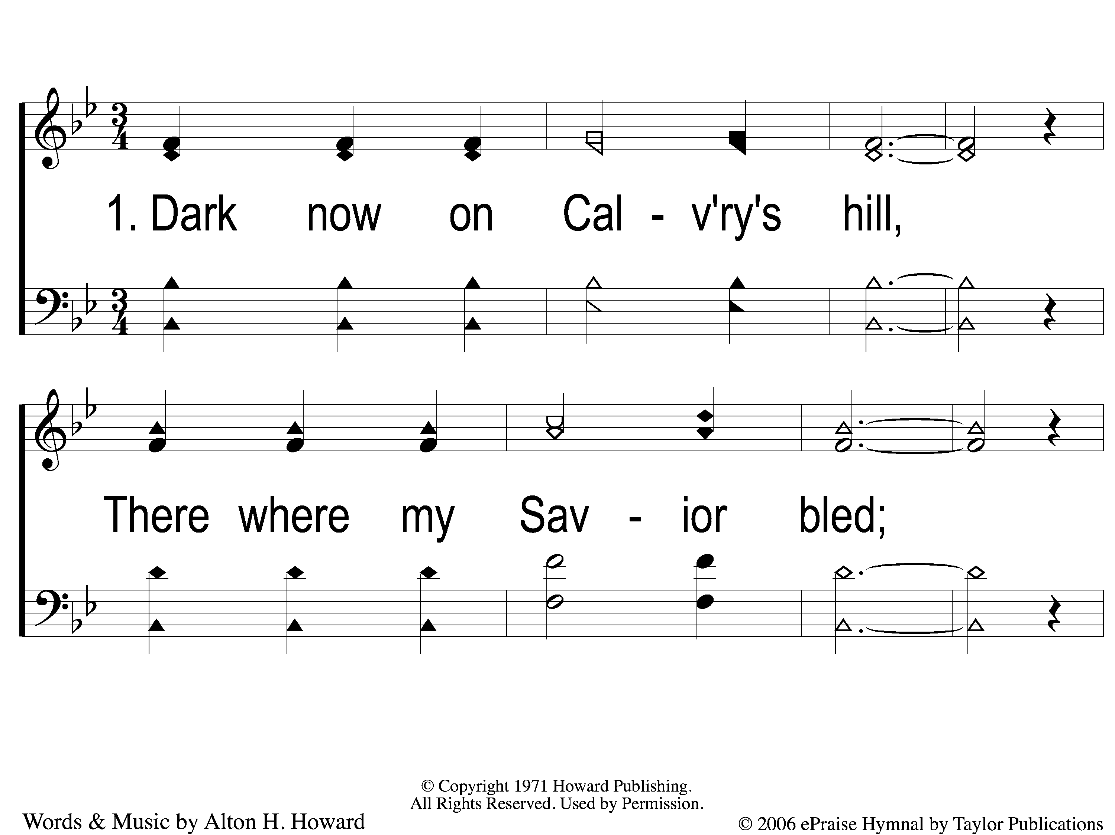
1-1 Did E’er Such Love
Did E’er Such Love
84

Slide 2
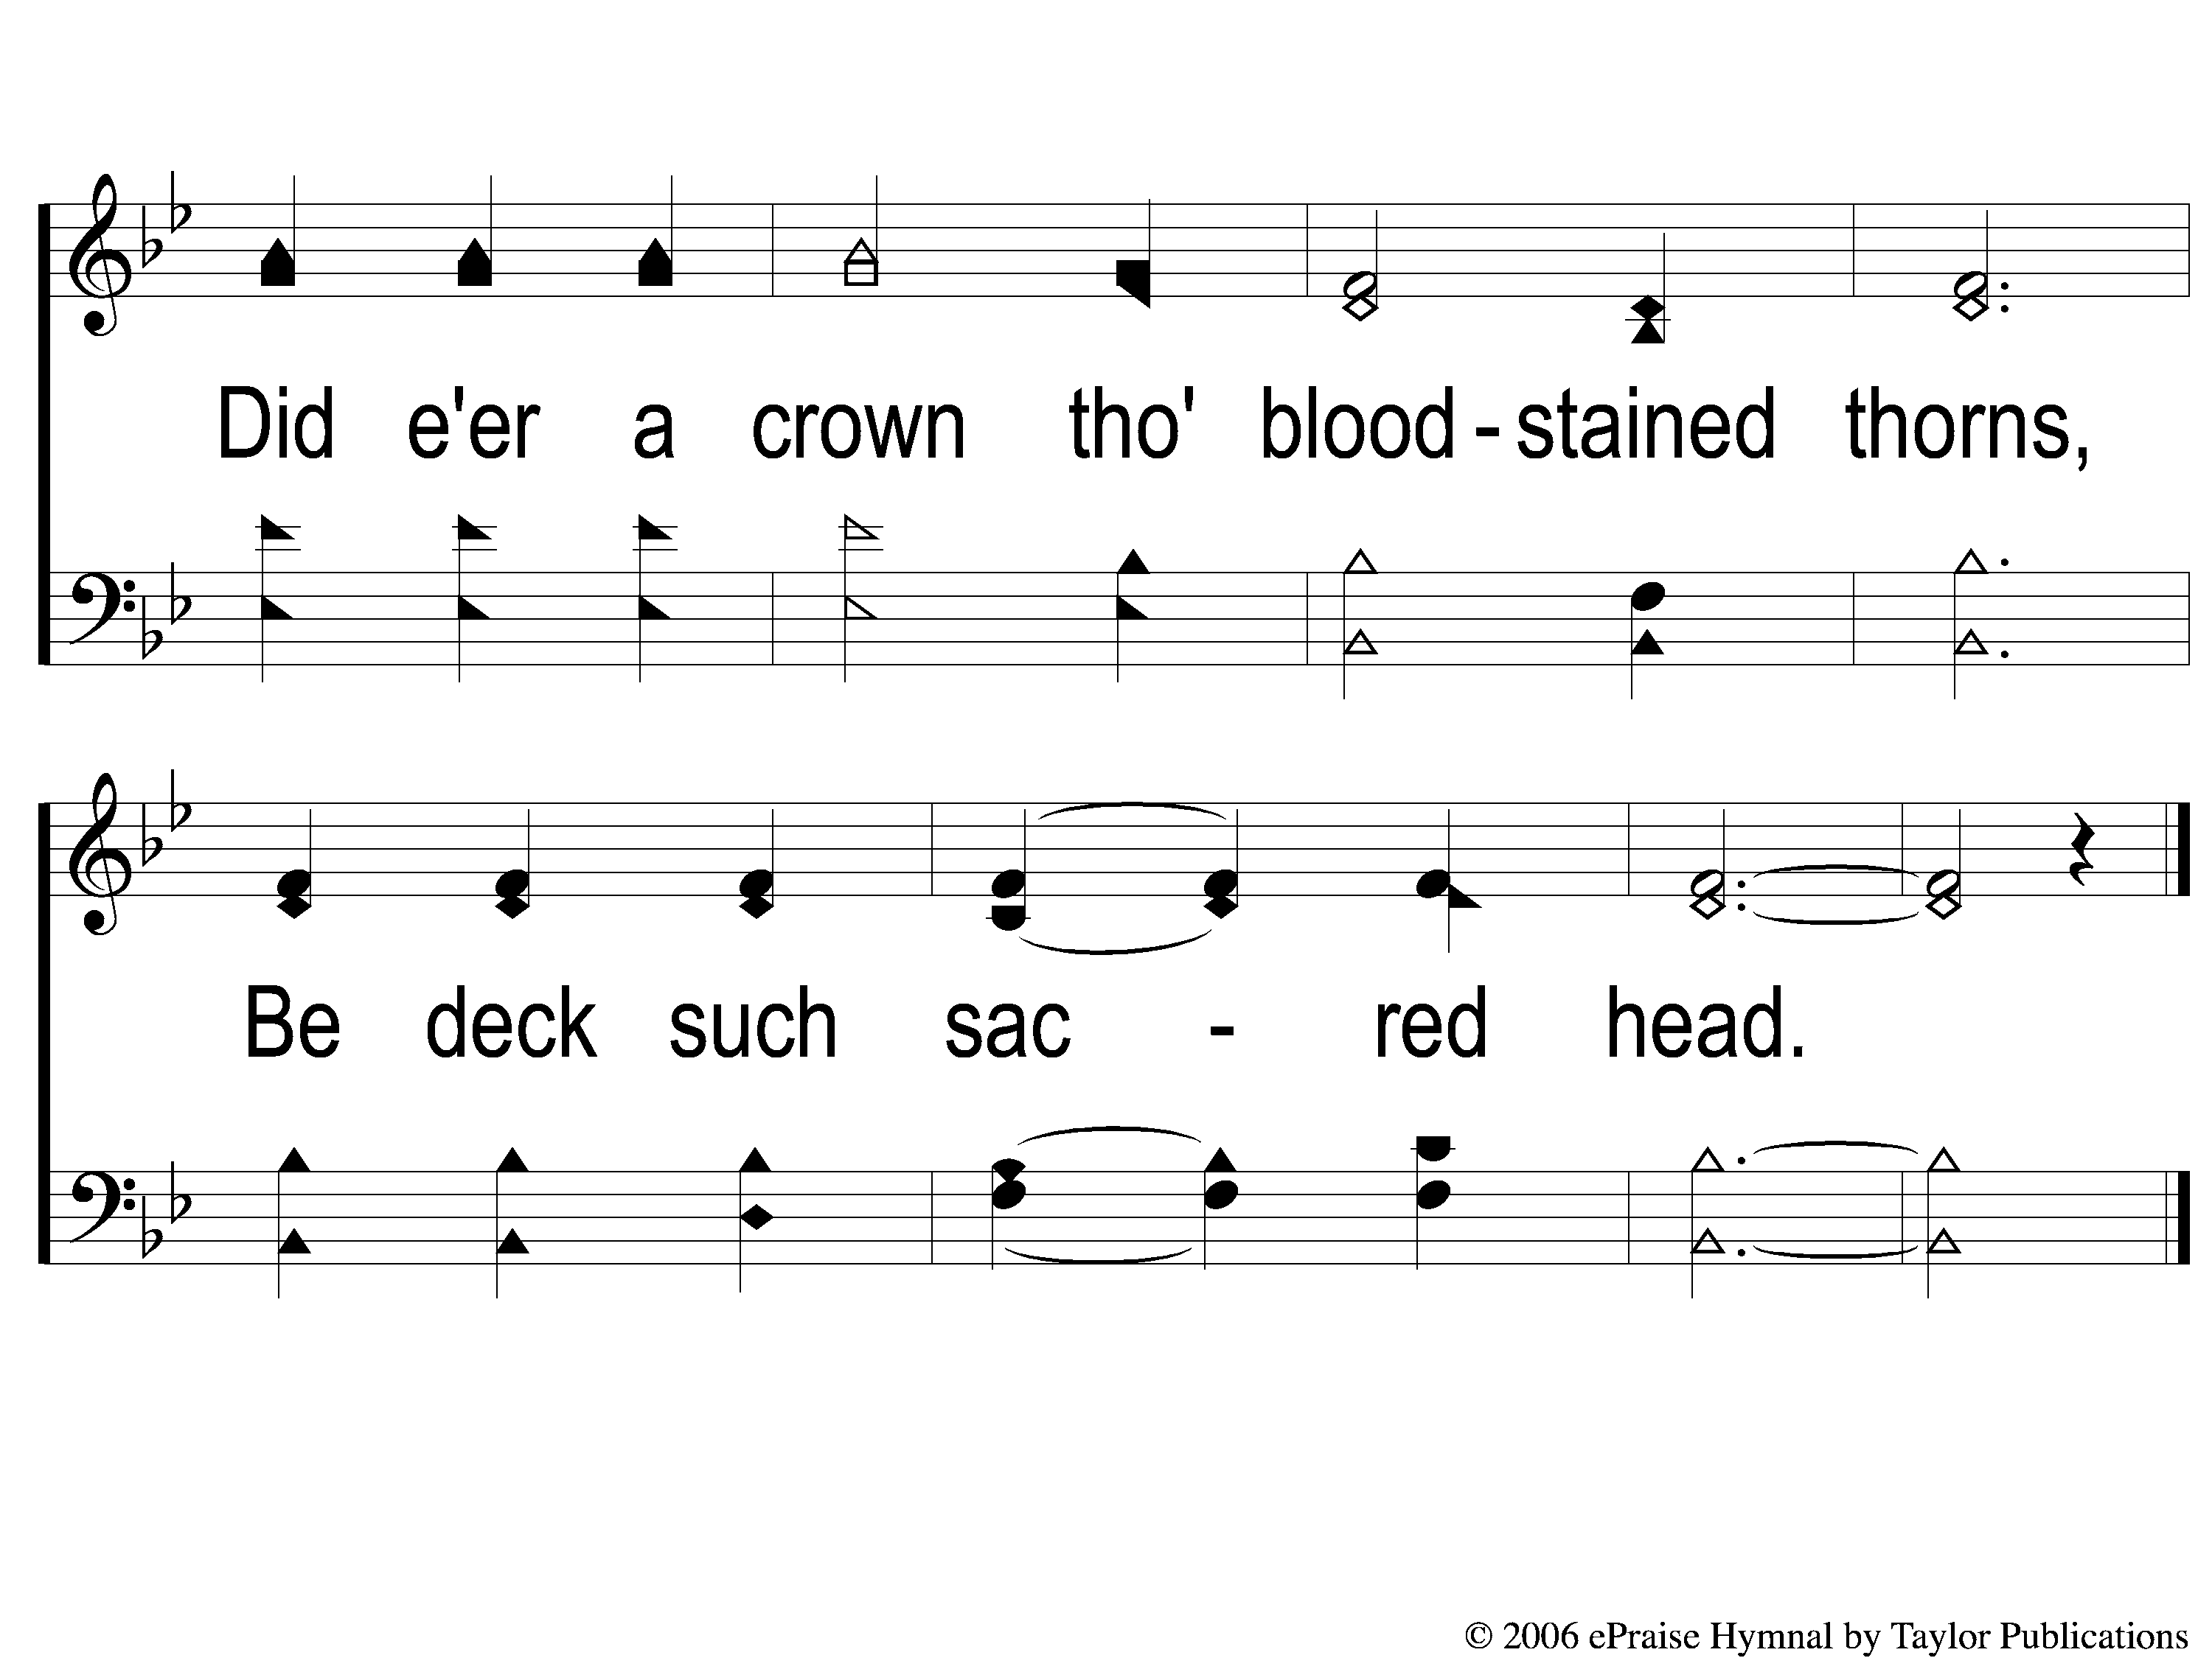
1-2 Did E’er Such Love
Did E’er Such Love
84

Slide 3
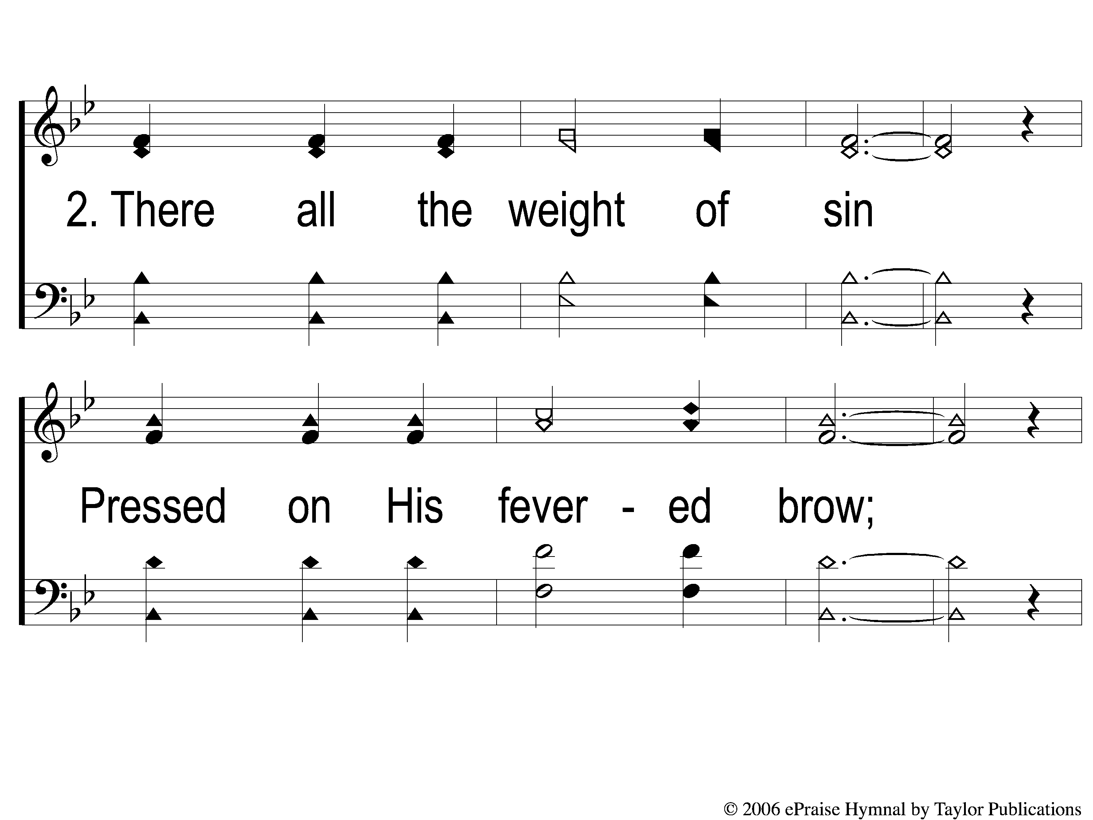
2-1 Did E’er Such Love
Did E’er Such Love
84

Slide 4
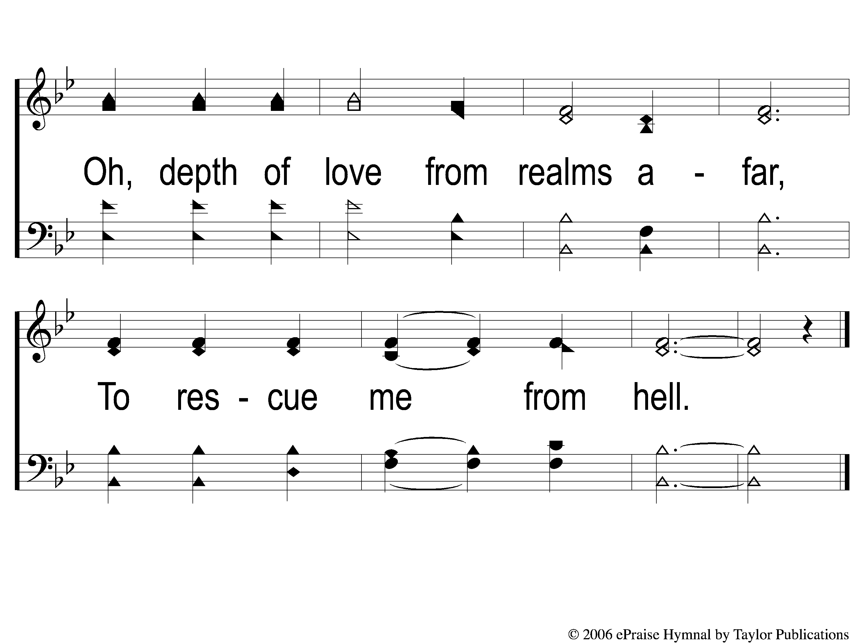
2-2 Did E’er Such Love
Did E’er Such Love
84

Slide 5
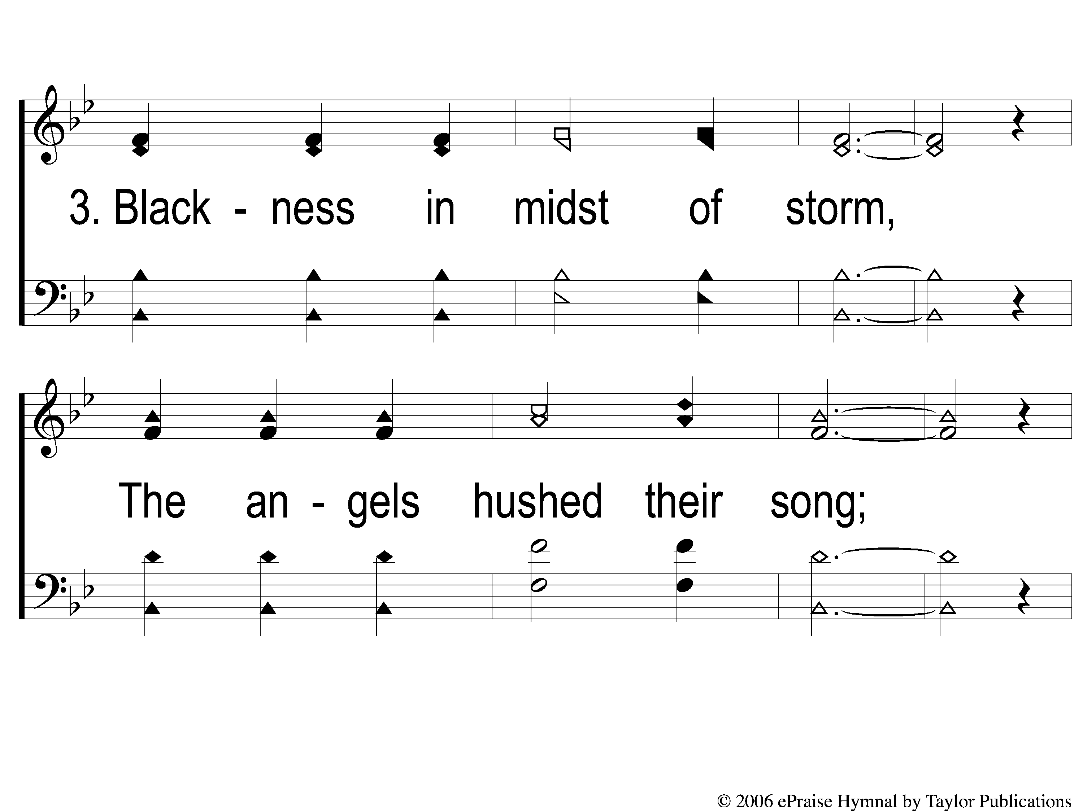
3-1 Did E’er Such Love
Did E’er Such Love
84

Slide 6
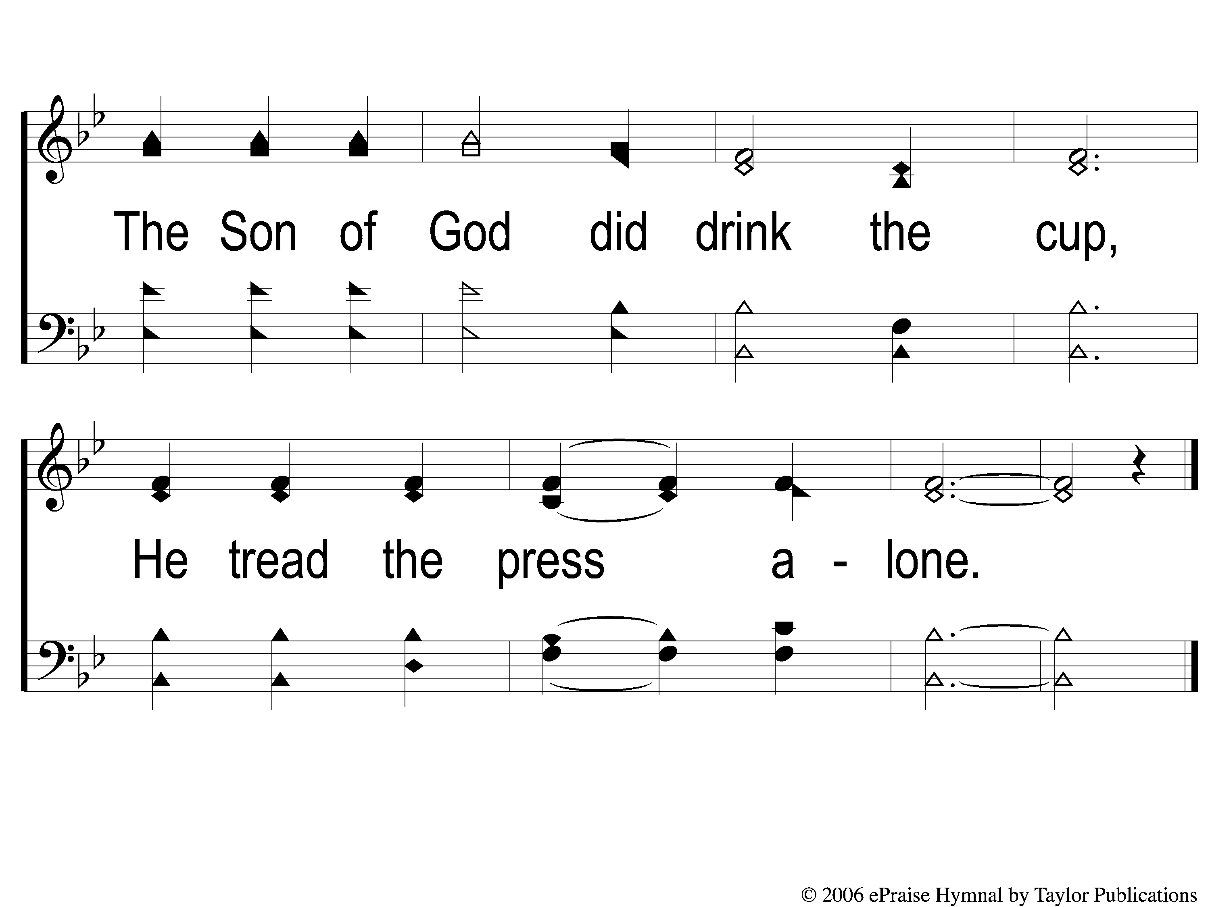
3-2 Did E’er Such Love
Did E’er Such Love
84

Slide 7
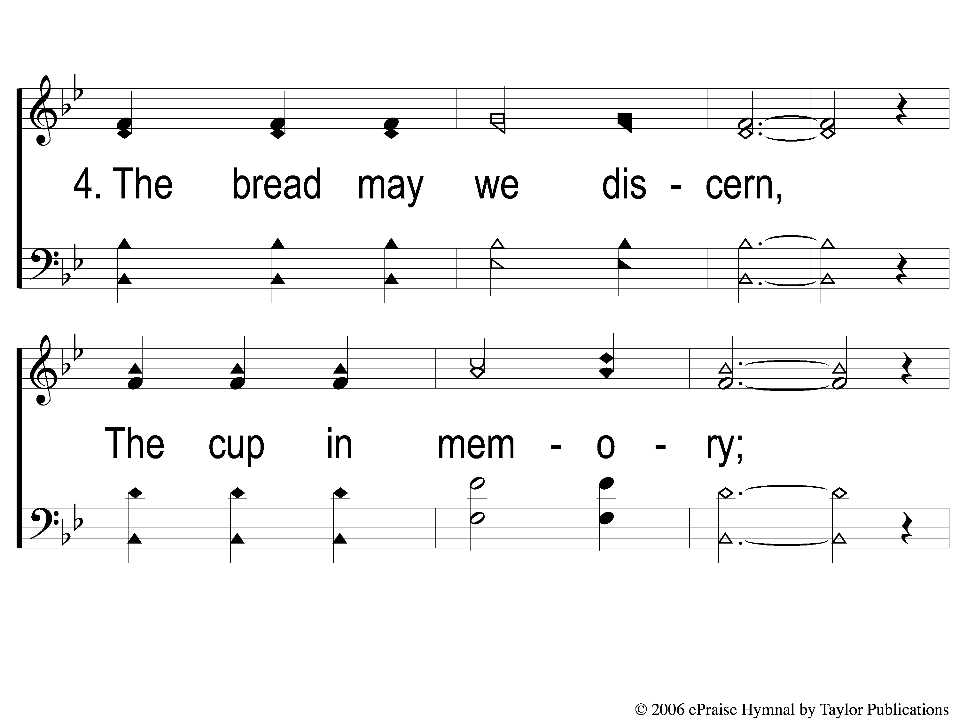
4-1 Did E’er Such Love
Did E’er Such Love
84

Slide 8
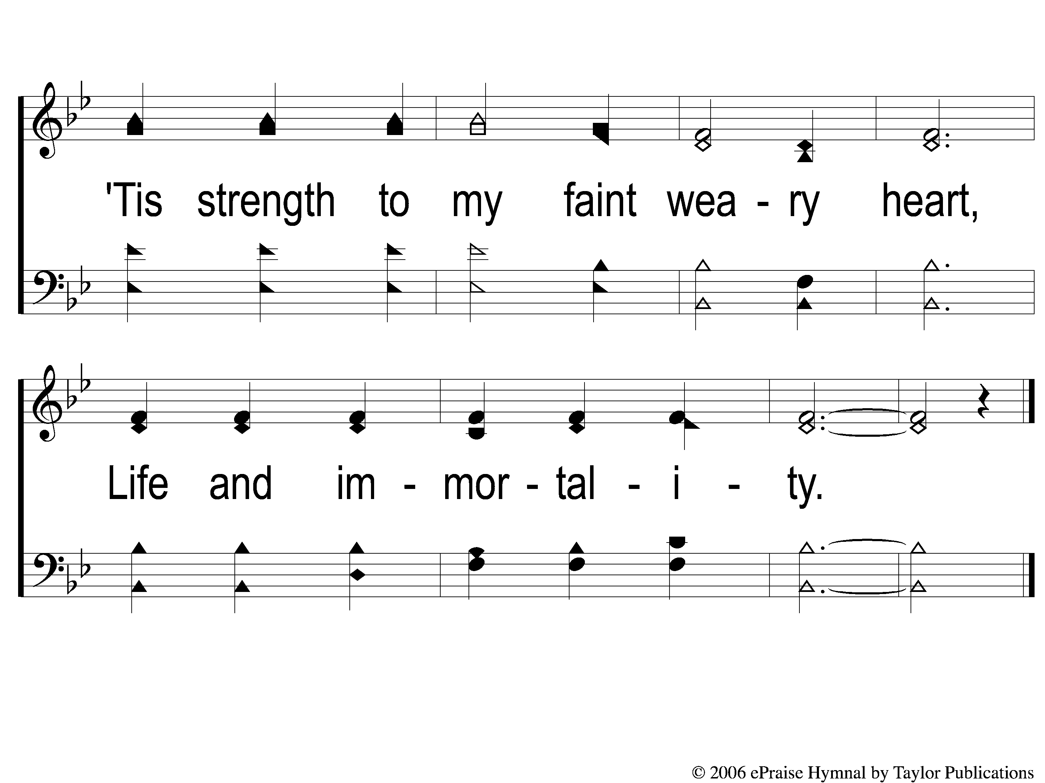
4-2 Did E’er Such Love
Did E’er Such Love
84

